Slide 1
MONITORING ACTIVITIES OF ELDERLY PEOPLE USING WEARABLE SENSORS AND SECURE COMMUNICATION TO REMOTE LOCATION

Slide 2
THE TEAM
Swayam Prakash Pati ; 19BCT0161
Rachit Elhance ; 19BCT0187
Rahul Chetan Thakar ; 19BCT0192
Disha Jain ; 19BCT0219

Slide 3
TABLE OF CONTENTS
01.
PROPOSED METHOD
02.
IMPLEMENTATION
03.
RESULTS
04.
CONCLUSION
05.
FUTUREWORK
06.
REFERENCES

Slide 4
INTRODUCTION
This paper presents a framework which utilises Wearable Sensors for data accumulation, a Smart-phone app to act as a Gateway and Cloud based services to provide necessary database management services. The system accumulates patient’s (elderly people) physiological data via wearable sensors (i.e., pulse, oxygen etc.) in real-time. Thus, any detection of disorder in a patient’s vitals will be reported to the patient's doctors and/or hospital in real-time to act on quickly and prevent a number of problems, such as a sudden heart attack, heat stroke, fall, etc.

Slide 5
01.
PROPOSED METHODOLOGY

Slide 6
COMPONENTS OF THE MODEL
Network of Wearable Sensors
Gateway
Wearable devices are connected to patients and operated over the IoT network.
Summary of patient's’ condition sent to the caregivers.
Monitoring Platforms
Cloud Datacenter
Data monitoring, and functionality controls over the collected data from sensors is done here.
Here, the main data storage, data display and disease detection activity are executed
Notes:
The data collected from the sensors need a 2-stage communication….

Slide 7
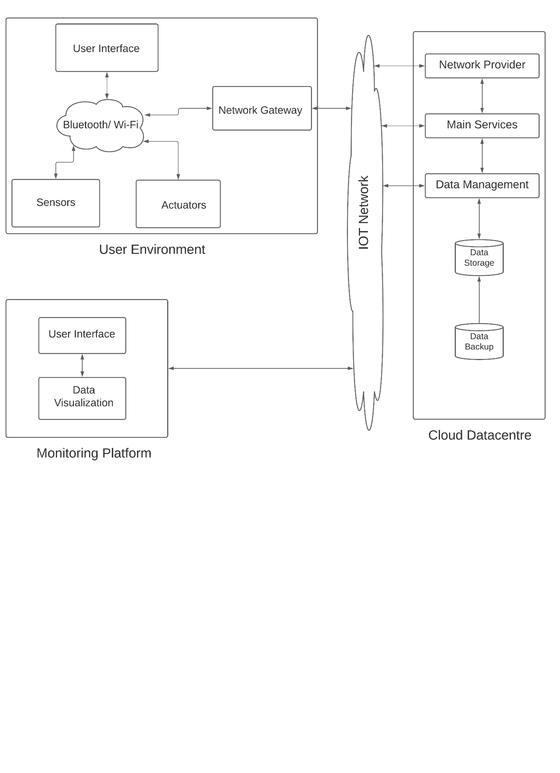

Slide 8
02.
IMPLEMENTATION

Slide 9
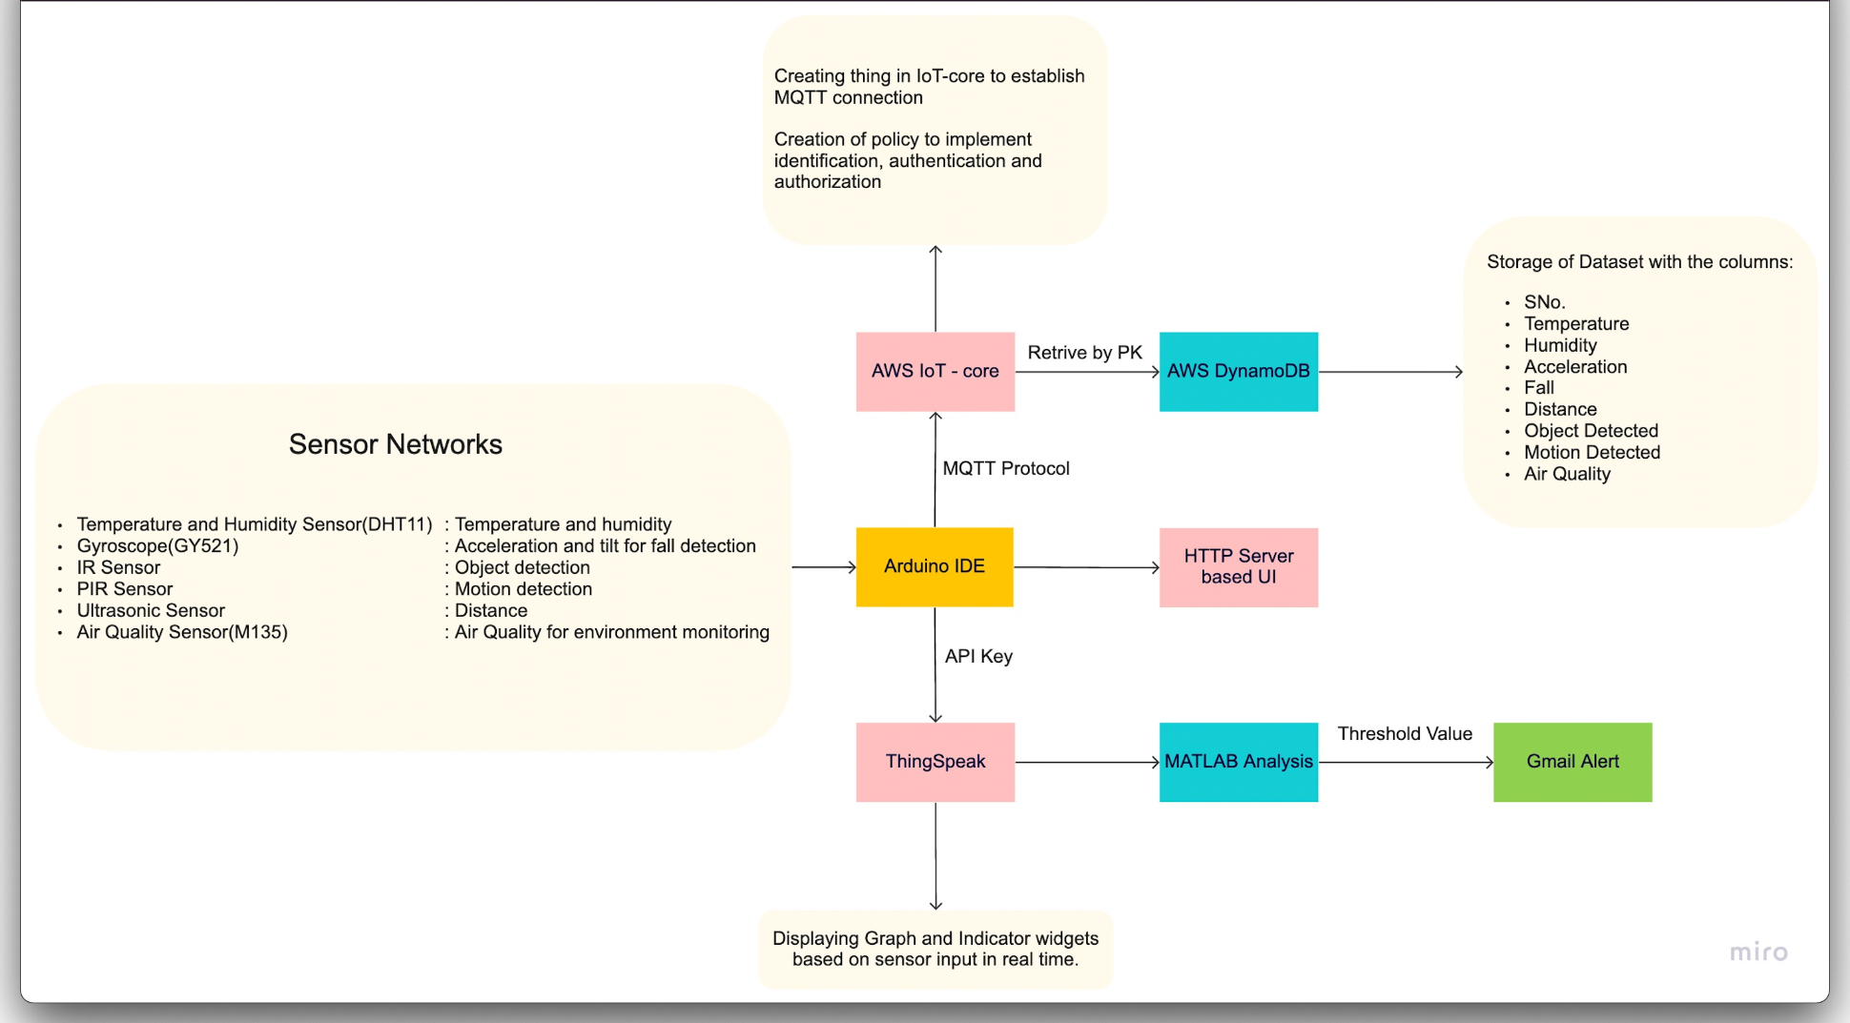
The applications are deployed in the AWS cloud and thus this is how we wish to implement it.
We will be using tools like AWS IoT Core and Amazon DynamoDB

Slide 10
AREAS WE COVER
Cardiovascular Monitoring System
Motion Monitoring System
Sleep Monitoring System
Environment Monitoring System
Respiration Monitoring System

Slide 11
NETWORK OF SENSORS
Sensors used in our project:
Temperature Sensor - For Temperature Monitoring
Accelerometer Sensor, Gyroscope, UltraSonic Sensor - For Fall Detection
Air Quality Gas Sensor - For Measuring the Toxicity in the Air
IR sensor - For Object Detection
PIR sensor - For Motion Detection

Slide 12
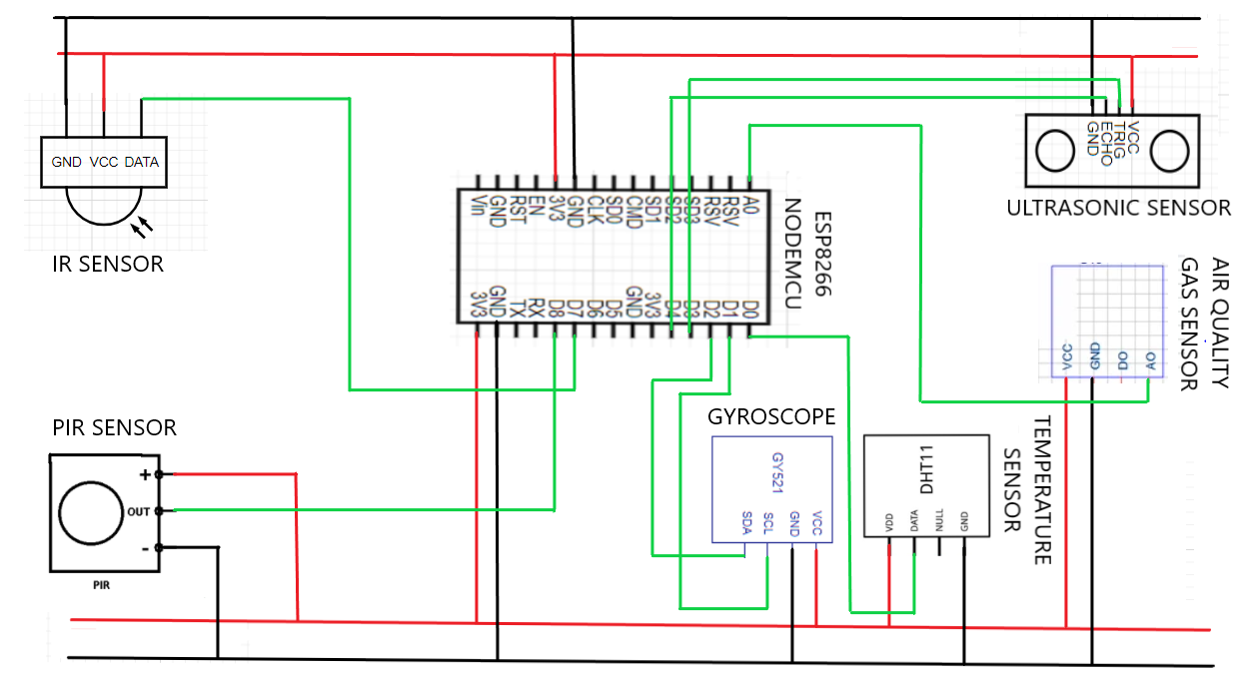

Slide 13
VISUALIZATION IN THINGSPEAK
Creating a new Channel; giving appropriate name and adding the required fields
After creating a channel, it is hosted as a private channel displaying the graphs for all the fields w.r.t. Date and time.Add appropriate widgets.
Edit the titles and axes w.r.t. fields displayed in the graphs.
In API keys we can see the read and write API keys of the channel. Add the write API key to the .ino file.
Make the channel public in the channel sharing settings
Next, we need the channel to create a new rule to trigger email whenever the data goes above or below the threshold. Under matlab analysis, select read data to trigger email and then create analysis.
In the next page, edit the relevant fields in the code then save and run the code to check for errors. The email will be triggered accordingly whenever the threshold value(s) are reached.

Slide 14
INITIALIZATION OF DYNAMODB TABLE WITH A CONNECTION WITH MQTT CLIENT
The AWS IOT CORE platform is used to create a thing named ESP8266 with the required details. The certificates and keys were downloaded accordingly.
We then created a policy named ESP8266 and connected it with the rightful certificate.
Next, the MQTT connection is set up named outTopic.
A rule is created on the IOT platform named ESP8266, and the required query statements are accordingly. Next a new table is created in DynamoDB named WASN Group 25 for which the partition key for Sl. No. with auto scaling options.
We then connected the DynamoDB table to the rule and defined the functions in the code accordingly.

Slide 15
ALGORITHM
Including all the relevant libraries for the sensors used
Adding special libraries that are included for reading and writing data we get from the temperature sensor.
Adding special libraries that are included for reading and writing data we get from the Gyroscope.
Adding special libraries that are included for reading and writing data we get from the Air Quality sensor.
Adding the rest of the libraries that are required for server upload functions, MQTT transmissions, HTML local server transmissions, NodeMCU operations, wifi connections and for performing simple read, write activities on serial monitor and AWS, Thingspeak clients.
Initializing variables
To send data to the Thingspeak server we create an ‘api-key’ variable and a server address variable to connect with thingspeak using its write api key.
To upload data to Thingspeak and the AWS server we create variables declaring the wifi and pass. The nodemcu will connect to the wifi using the details.
Initializing all the variables required for data processing and assigning variables for the GPIO pins used.
Initializing broker id and wificlient to set and send MQTT to AWS server.
Creating a setup_wifi() to connect to the wifi. Create the following reconnect function to loop until we are connected to the MQTT server client.

Slide 16
Inside the void setup() we set up the serial monitor to print our data locally.
Setting pins for INPUT and OUTPUT modes according to the sensors and their corresponding GPIO pin variables.
Creating a Heap for private,public keys and certificates for the AWS Thing.
Begin the HTTP local server.
Inside the loop() we post the data onto the Thingspeak, AWS and HTTP servers for the outputs.
Get all the data from the connected MPU and perform relevant operations to get the desirable output values from the Temperature, IR(obstruction), PIR(motion), gyroscope(acceleration and axis tilt), and Ultrasonic(proximity) sensors.
Segregating all the data as different field variables and sending the data to the Thingspeak server via MQTT.
Uploading all the data onto the AWS server in th JSON format, to be displayed in DynamoDB, using MQTT.
Locally displaying all the information on the HTTP server.
Closing any open connections when the transmission process is manually terminated.

Slide 17
IMPLEMENTATION OF USER INTERFACE
We are rendering the HTML code for the user interface from the source code itself by using the library ESP8266WebServer.h.
We use the function SendHTML to append the HTML code with the parameters and send it to the server for the user to see.
An empty string is defined in the function, where the entire HTML code is appended with the CSS properties and SVGs and the received physiological data.
This entire string is then returned and thus the web page for the end user is shown on the server.

Slide 18
03.
RESULTS

Slide 19
Let us have a demonstration from our side now !

Slide 20
04.
CONCLUSION

Slide 21
The project focused on retrieving physiological data from the wearable sensors worn by the patients and storing it in the database as well as displaying it at all times to the health monitoring department to avoid any casualties. The network of wearable sensors was created with the help of jumper wires and a breadboard. The microcontroller ESP8266, acting as the gateway successfully transmitted the data to the cloud with the help of the AWS IoT platform. The data was fetched from the microcontroller and was sent to the User Interface for the healthcare monitoring department to see and keep a check. The system works properly and efficiently. The data is transmitted in real time and is recorded in a timely. The statistical graphs are also displayed accordingly. The alerts are also sent as soon as any of the incoming parameters cross the threshold values. application. Right now, the proposed system has a limited battery source which can be improved as well to accomodate more sensors.

Slide 22
05.
FUTURE WORK

Slide 23
The system of wearable sensors can be improved by adding more efficient sensors for providing more accurate and detailed results. The multiple application sensors would be very beneficial as that would reduce the cost and number of sensors used in the system. Many creative low cost sensors exist but are not used that often. With a good amount of research in the sensor domain, low cost sensors can be introduced to the system making it even more affordable for the hospitals and the end users.The network of sensors can be made more compatible and comfortable for the patients.
Human requirements for comfort, durability, and often aesthetics are always changing, so technological capabilities in terms of accuracy, performance, and modalities could be explored and worked on accordingly. As Big Data and IoT wearables become increasingly prevalent, they are likely to enable new medical tools and biomarkers for the elderly, enabling home care and pharmaceutical treatment by speeding up and optimizing clinical trials.
With the help of Machine Learning, datasets from Kaggle or UCL can be used for disease prediction as the function will be working for a finite number of diseases. This increases the flexibility and accuracy of the disease prediction function of our system. New datasets can be generated using our algorithm for further prediction of diseases which did not exist in the detection applications of the real world.

Slide 24
06.
REFERENCES

Slide 25
[1] https://electronicsinnovation.com/storing-esp8266-data-into-amazon-dynamodb-using-aws-iot-coremqtt-arduino/
[2] https://electronicsinnovation.com/how-to-connect-nodemcu-esp8266-with-aws-iot-core-using-arduino-ide-mqtt/
[3] https://aws.amazon.com/console/
[4] https://stackoverflow.com/
[5] https://thingspeak.com/

